Slide 1









Employee Management
System
Presented by
Sourav Varma G

Slide 2






What is Employee Management System?
A system used to manage employee data
Tracks departments, job roles, salaries, leaves
Used for payroll processing
Improves HR efficiency

Slide 3









Objectives of EMS
Generate payroll automatically
Track leaves and qualifications
Provide insights through SQL analysis
Store employee and department information
Maintain salary & bonus structure

Slide 4




Problem Statement
The main problem is that employee information in a company is often stored in different places — like files, spreadsheets, or notes. Because of this, it becomes difficult to track employee details, salary, leaves, qualifications, and payroll correctly.
This can lead to mistakes, missing data, and a lot of extra work for the HR team.
So, the purpose of this project is to create one proper SQL database where all employee-related information can be stored, updated, and analyzed easily.
With this system, the company can manage employees, departments, salaries, bonuses, leaves, and payroll in an organized and error-free way.

Slide 5









Database Tables
Employee
Qualification
JobDepartment
SalaryBonus
Payroll
Leaves

Slide 6
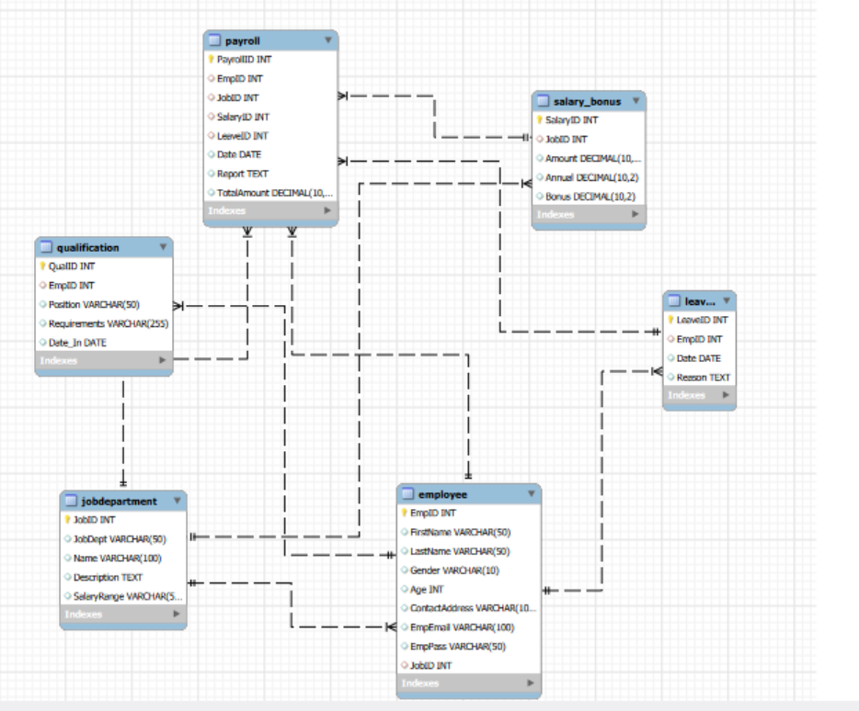



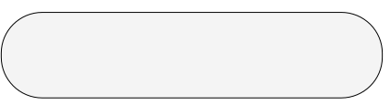


ER DIAGRAM
The diagram models an HR management system.
employee stores staff details, linking to jobdepartment, qualification, and leaves.
jobdepartment defines roles and departments.
qualification lists employee qualifications.
leaves records employee leave details.
payroll calculates pay, combining job, salary, and leave data.
salarybonus specifies pay and bonuses for each job.

Slide 7


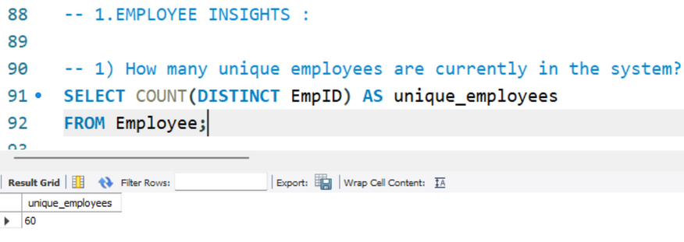
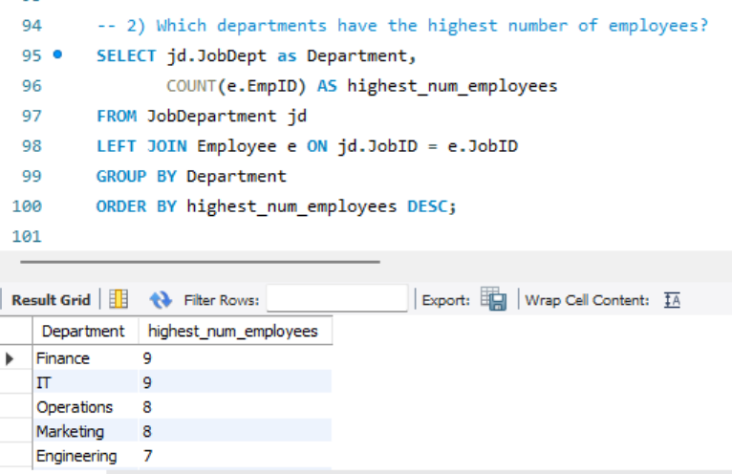

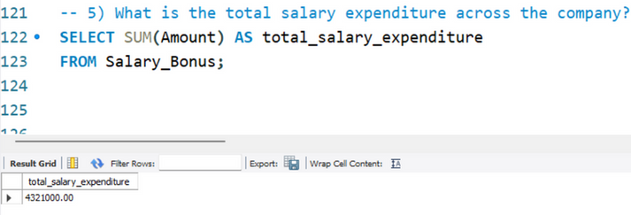
EMPLOYEE INSIGHTS
How many unique employees are currently in the system?
Which departments have the highest number of employees?
What is the total salary expenditure across the company?

Slide 8


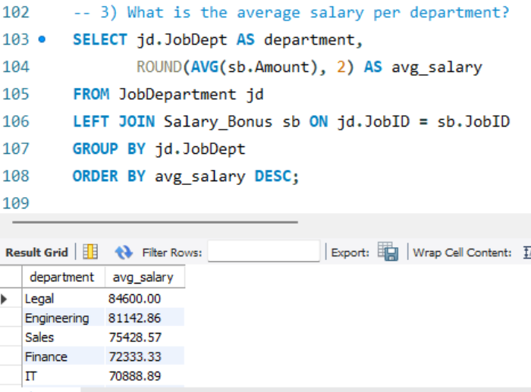
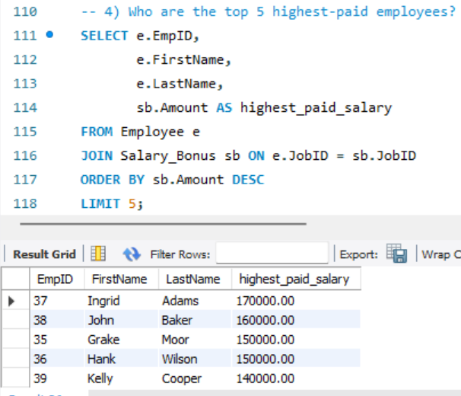
EMPLOYEE INSIGHTS
What is the average salary per department?
Who are the top 5 highest-paid employees?

Slide 9
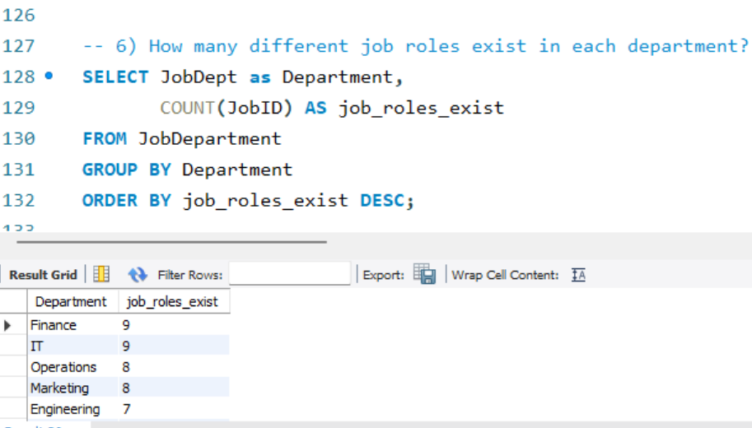
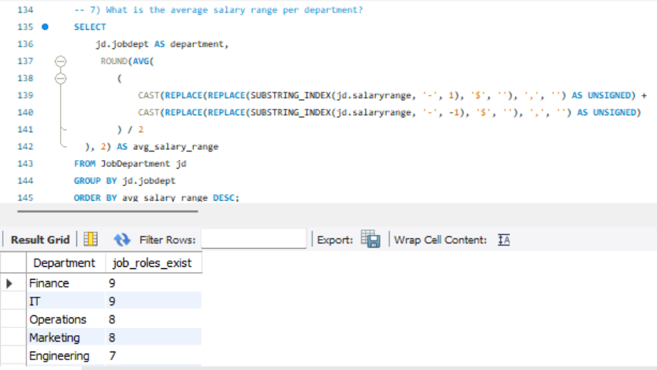
JOB ROLE AND DEPARTMENT ANALYSIS
How many different job roles exist in each department?
What is the average salary range per department?

Slide 10
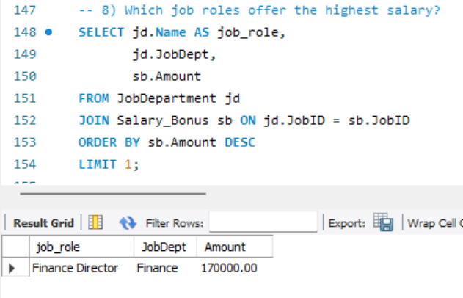
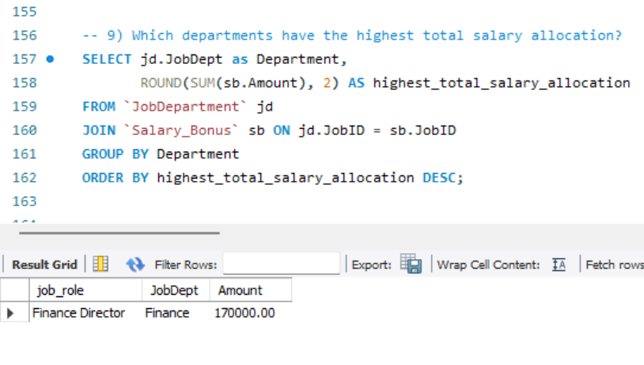
JOB ROLE AND DEPARTMENT ANALYSIS
Which job roles offer the highest salary?
Which departments have the highest total salary allocation?

Slide 11
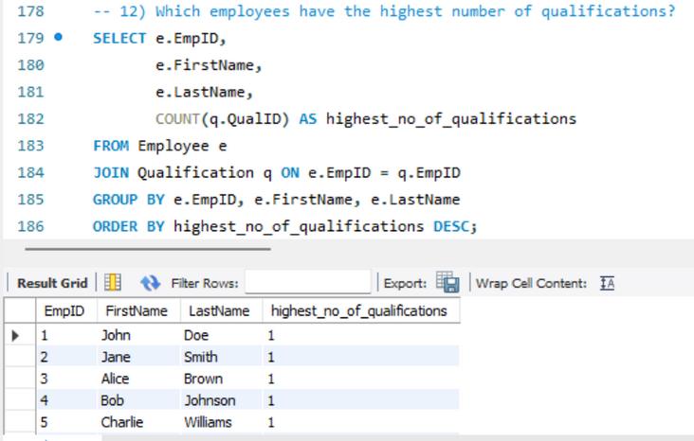
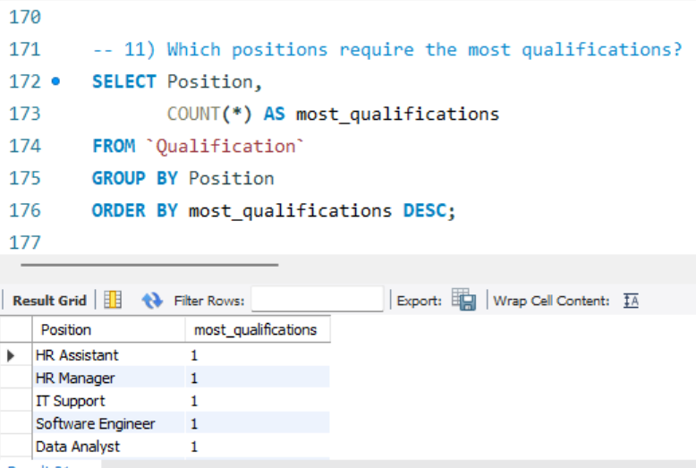

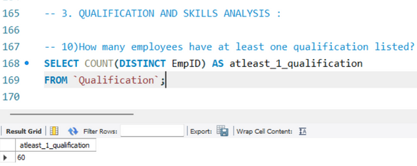
QUALIFICATION AND SKILLS ANALYSIS
Which employees have the highest number of qualifications?
Which positions require the most qualifications?
How many employees have at least one qualification listed?

Slide 12

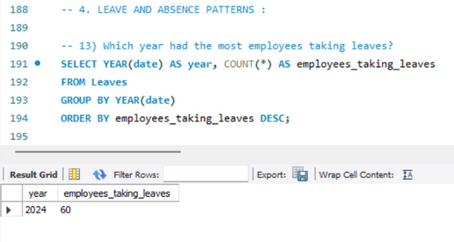
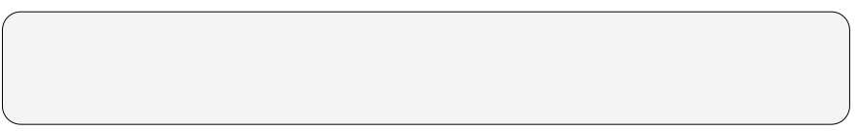
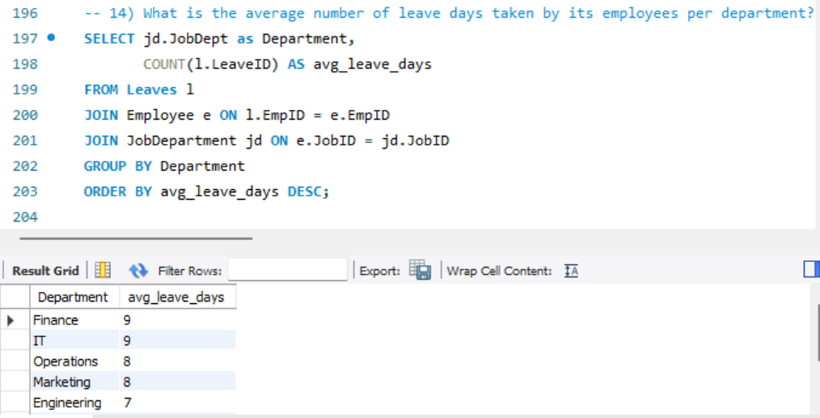
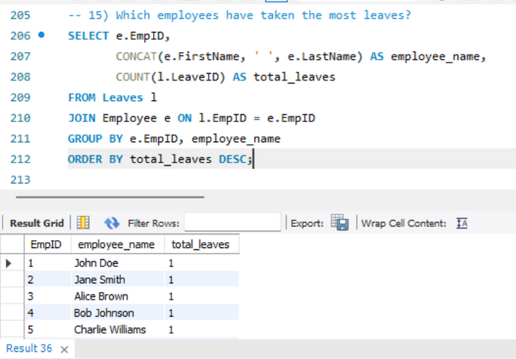
LEAVE AND ABSENCE PATTERNS
Which year had the most employees taking leaves?
What is the average number of leave days taken by its employees per department?
Which employees have taken the most leaves?

Slide 13
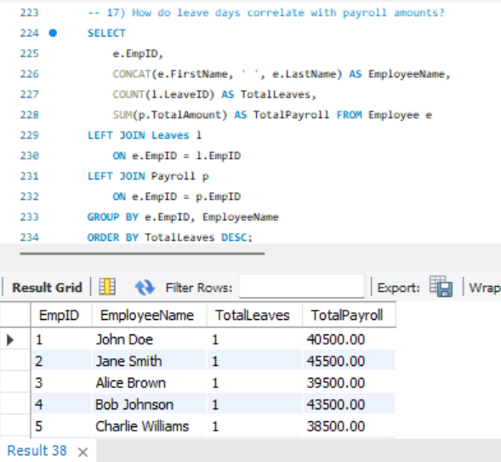
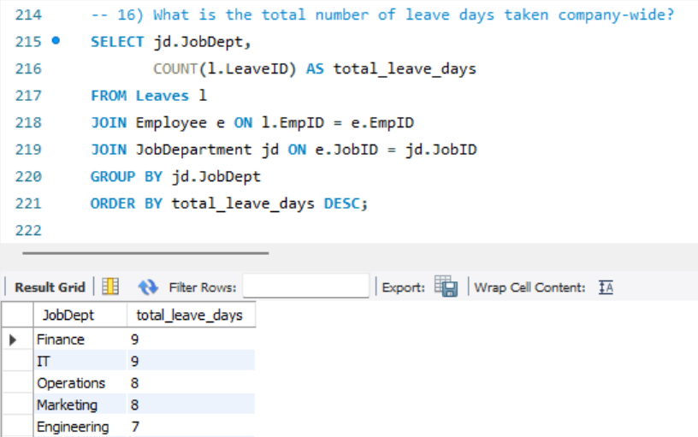
LEAVE AND ABSENCE PATTERNS
How do leave days correlate with payroll amounts?
What is the total number of leave days taken company-wide?

Slide 14
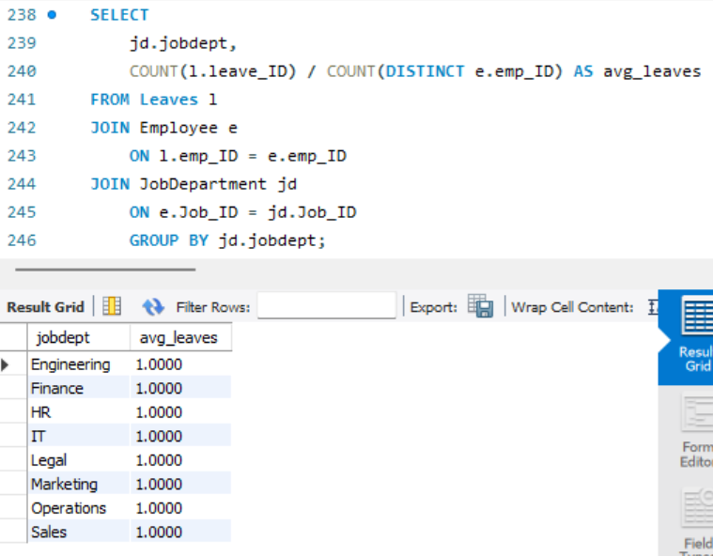
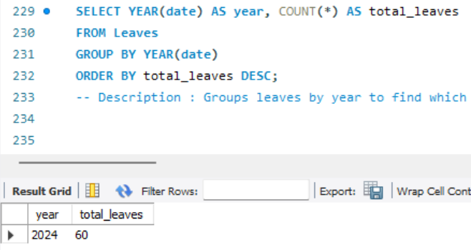
LEAVE AND ABSENCE PATTERNS
Which year had the most employees taking leaves?
What is the average number of leave days taken by its employees per department?

Slide 15
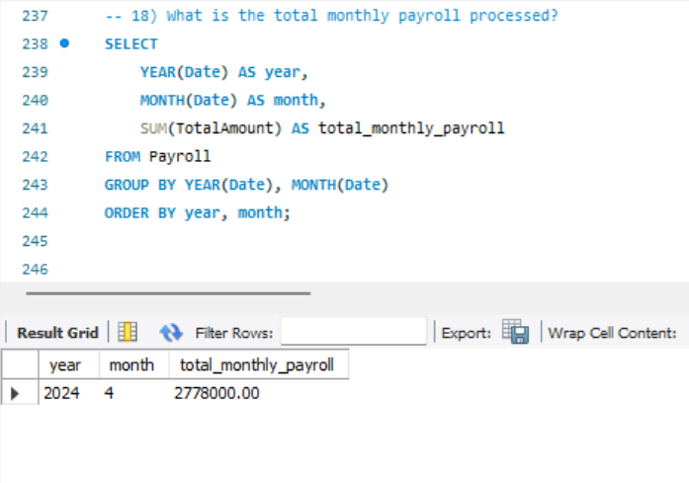
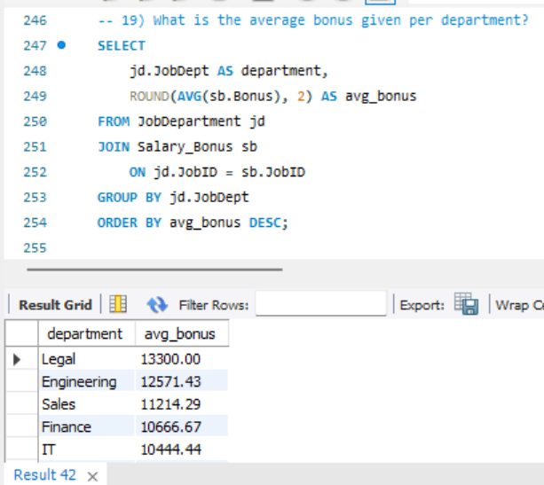
PAYROLL AND COMPENSATION ANALYSIS
What is the total monthly payroll processed?
What is the average bonus given per department?

Slide 16

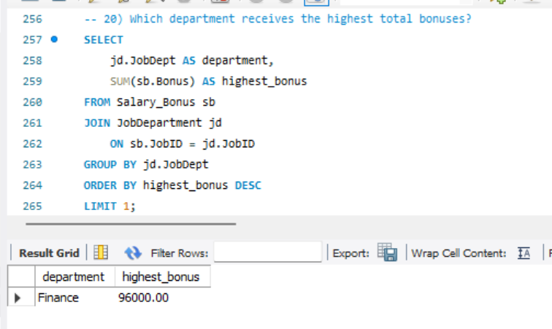
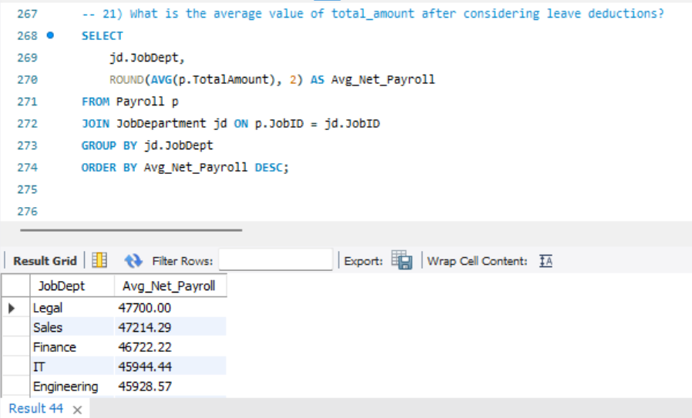
PAYROLL AND COMPENSATION ANALYSIS
Which department receives the highest total bonuses?
What is the average value of total_amount after considering leave deductions?

Slide 17

SUMMARY
The Employee Management System (EMS) is a structured SQL-based solution designed to efficiently manage employee data, job roles, salary structures, qualifications, leave records, and payroll. By using relational tables and foreign key constraints, the system ensures data consistency and smooth HR operations.
This project demonstrates the ability to design an end-to-end database, import interconnected datasets, and perform advanced SQL queries to generate meaningful business insights across HR, payroll, and departmental operations.

Slide 18







KEY INSIGHTS
Minimal data inconsistencies, showing a clean, reliable HR system.
Leave patterns show predictable annual trends, useful for planning.
Departments with higher skills demand show higher payroll allocations.
Payroll remains consistent, and bonuses correlate with high-value roles.
Top salaries align strongly with strategic roles, indicating structured compensation.
Employee count is stable, with clear distribution across departments.
Qualifications match job requirements, proving efficient hiring alignment.
IT & HR hold the most employees, showing core operational strength.

Slide 19

CONCLUSION
The Employee Management System SQL project successfully demonstrates real-world database design, data normalization, and analytical querying.
It provides actionable insights into employee structure, payroll efficiency, departmental performance, and workforce trends.
The system ensures accurate HR operations through linked tables and structured constraints, making it a scalable and reliable solution for organizational data management.

Slide 20
THANK YOU

